Slide 1
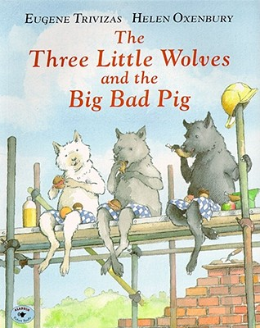
The Three Little Wolves and the Big Bad Pig

Slide 2
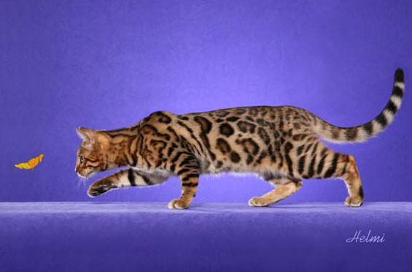
prowling
Looking for something secretly and quietly
The cat was prowling around, trying to catch the butterfly.

Slide 3
determined
Deciding to do something and sticking to it until it is done
It was a tough job, but the ducks were determined to climb out of the water.

Slide 4
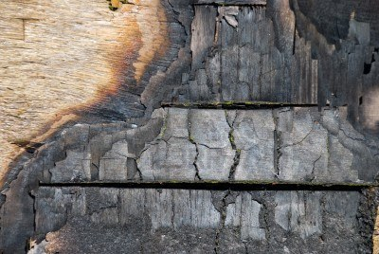
scorched
Leaving a brown mark after being burned
The wood was scorched from the fire.

Slide 5
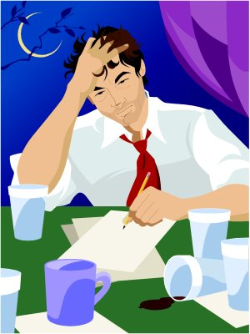
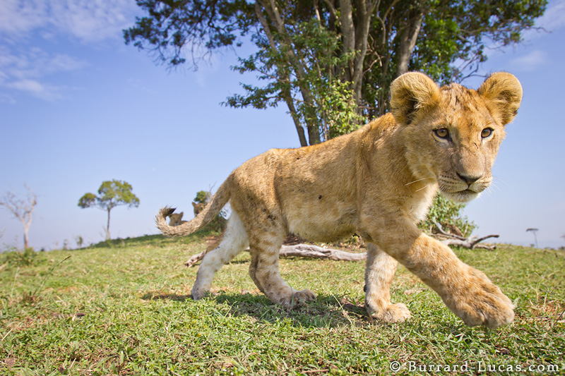
Which goes with prowling?

Slide 6
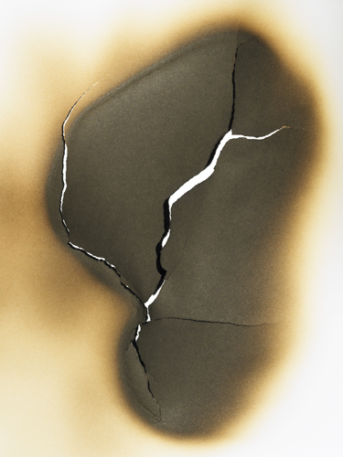
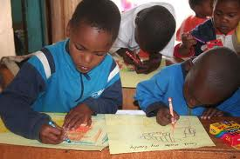
Which goes with determined?

Slide 7
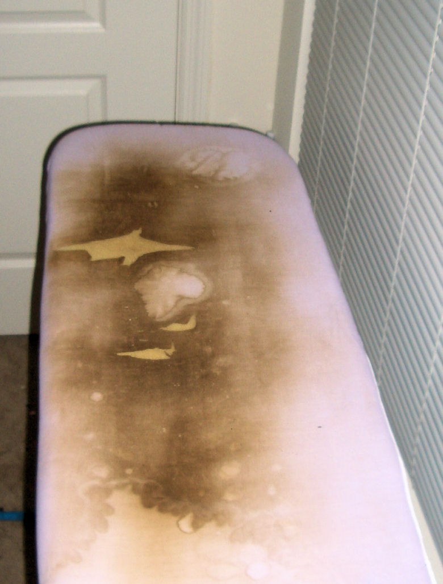
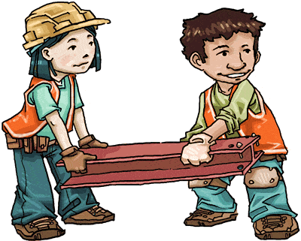
Which goes with scorched?

Slide 8
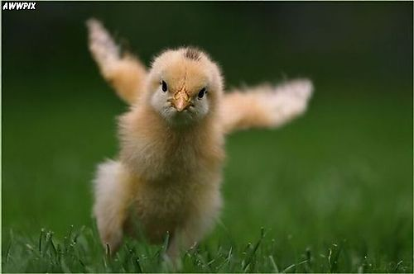
Which word goes with this picture? (prowling, determined, scorched)

Slide 9
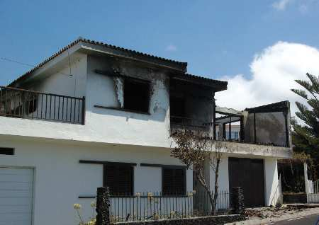
Which word goes with this picture? (prowling, determined, scorched)

Slide 10
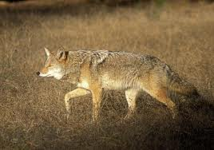
Which word goes with this picture? (prowling, determined, scorched)

